Slide 1

Multilingual PII Detection System: An Overview
Discover our advanced system detecting personally identifiable information worldwide.
We combine multiple techniques for greater accuracy and language coverage.

Slide 2
System Architecture: A Hybrid Approach
Core Components
Design Highlights
Hugging Face transformers for context-aware detection
Modular system for easy updates and scaling
Presidio pattern recognisers for reliable pattern matching
Clear pipeline from input to redaction
Flexible integration across components
spaCy NER models for efficient text analysis
Custom regex for tailored pattern extraction

Slide 3

Multilingual Support: Languages and Modules
English Module
Transformer and spaCy models with refined regex patterns.
French Module
Custom transformers and linguistic rules unique to French.
Arabic Module
Specialized NER and pattern recognisers for Arabic script.
Future Plans
Scalable framework designed to add more languages easily.

Slide 4
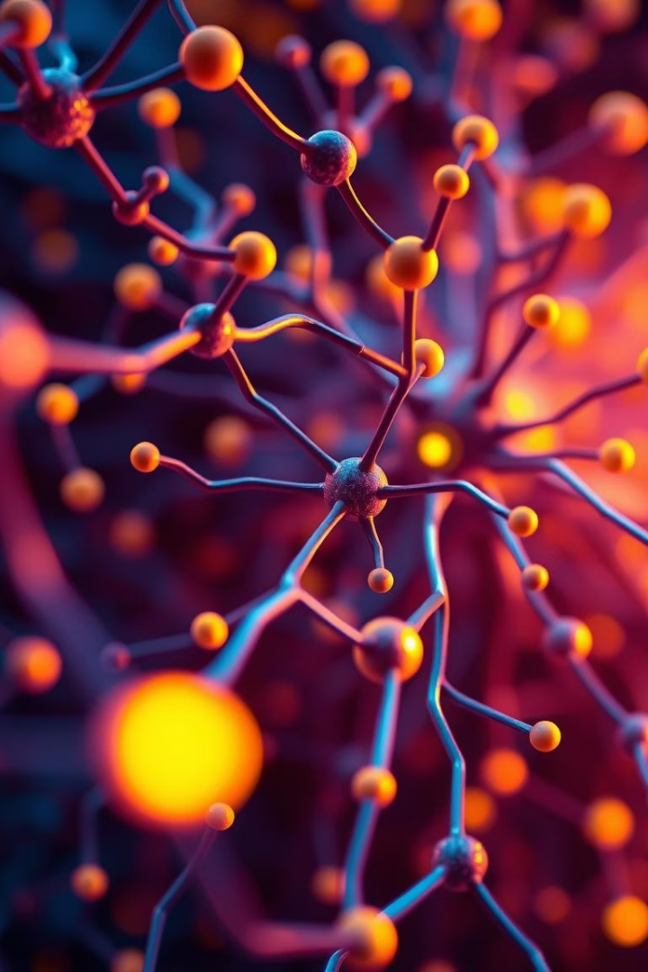
Model Type: Transformers
Hugging Face Transformers
Contextual Embeddings
Pretrained transformer models fine-tuned per language.
Capture nuanced meaning beyond traditional methods.
Accurate NER
Recognise entities precisely even in complex sentences.

Slide 5

Model Type: Presidio Pattern Recognisers
Complementary Role
Custom Regex
Supports transformers by catching edge cases and structured data.
Rule-Based Detection
Easily adapt patterns to unique datasets or languages.
Identify common PII patterns reliably with rules.

Slide 6
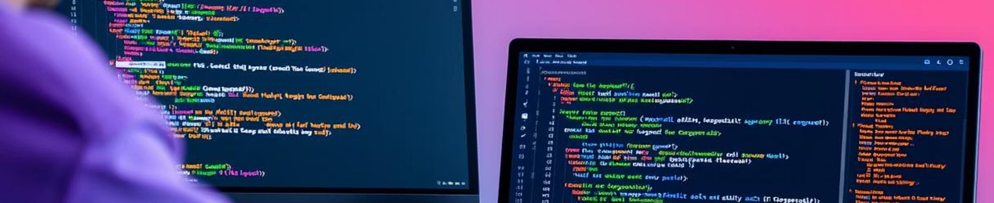
Model Type: spaCy NER Models
Efficient Processing
Language-Specific Models
Integration Benefits
Fast and lightweight NER models tailored per language.
Leverage spaCy's strong pipeline for text processing tasks.
Enhance detection accuracy with tailored training.

Slide 7

Advanced Techniques: Adaptive Thresholding
Dynamic Confidence
False Positive Control
Custom Optimisation
Adjust detection sensitivity based on context and data type.
Reduce incorrect PII tagging effectively.
Tailor thresholds per language and module.

Slide 8
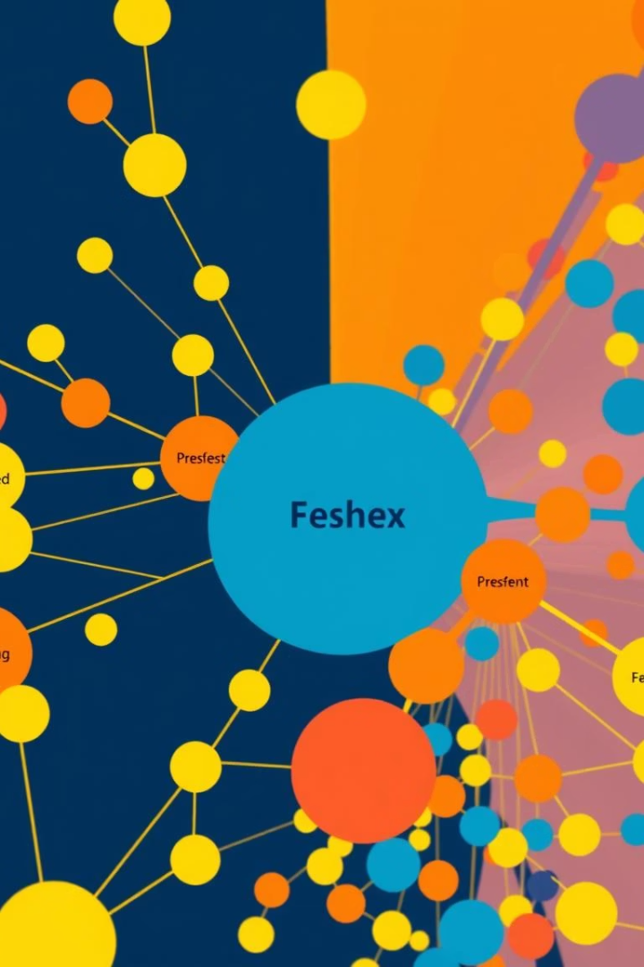
Advanced Techniques: Semantic Merging
FastText Embeddings
Entity Merging
Analyse semantic similarity among detected PII.
Combine similar entities to reduce redundancy.
Effective Redaction
Improve data privacy by targeting all related PII.

Slide 9

Performance Metrics and Evaluation
Language
Precision
Recall
F1-Score
English
98%
89%
90.5%
French
94%
89%
87%
Arabic
82%
79%
81.5%
The system outperforms traditional baselines across all languages.

Slide 10
Conclusion: Advantages and Future Directions
Hybrid approach ensures robust and precise PII detection
Research will focus on increasing language coverage and optimising GPU acceleration.
Strong multilingual capabilities with continuous enhancements
Next steps include expanding redaction strategies and AI explainability.
Adaptable framework supports future language additions

